Slide 1
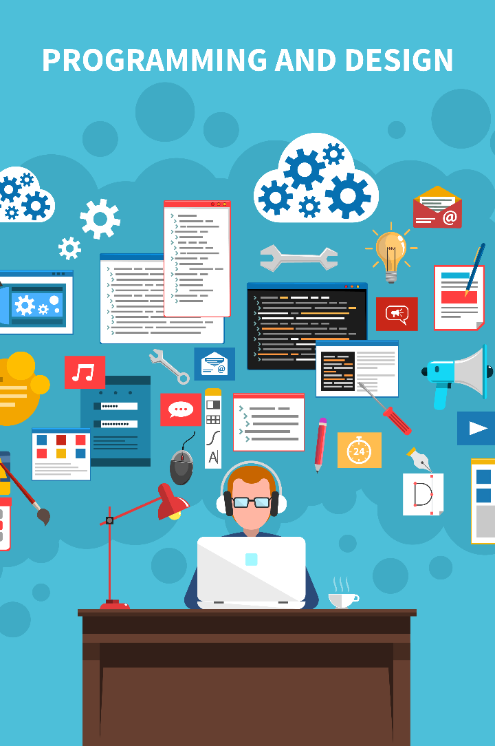
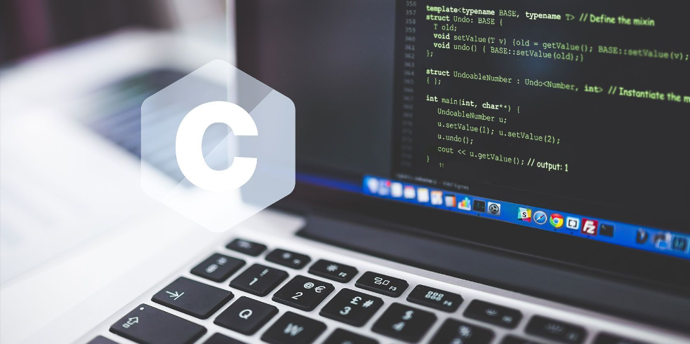
Introduction to Programming and C
Discover the exciting world of programming and explore the fundamentals of the C language. Learn how programming impacts our daily lives and why C is a valuable language to master.

Slide 2

Programming Concepts
Programming is the art of giving instructions to a computer to perform specific tasks. It involves problem-solving, logic, and creativity. By learning programming concepts, you gain the ability to create software, websites, and more.

Slide 3

Programming Languages
Python
JavaScript
Java
A versatile language known for its simplicity and readability. It's perfect for beginners and has a wide range of applications, from web development to data analysis.
The language of the web. It adds interactivity and dynamic elements to websites. It's also used in server-side development, mobile app development, and game development.
A powerful language used in everything from Android app development to enterprise-level systems. It's known for its portability and scalability.
C/C++
A popular language used for system programming, embedded systems, and high-performance applications. It provides low-level control and efficient memory management.

Slide 4


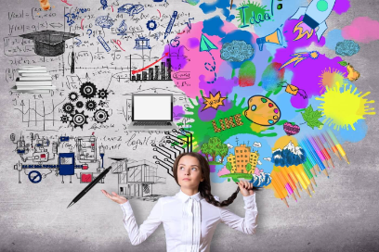

Benefits of Programming in Our Daily Life
1
Automation 🤖
2
Creative Expression 🎨
Automate repetitive tasks to save time and increase efficiency in your daily life. From home automation to data analysis, programming can simplify your routines.
Use programming to bring your ideas to life through games, art, music, and more. It's a powerful tool for self-expression and exploring your creativity.
3
Critical Thinking 🧠
Programming enhances problem-solving skills, improves logical thinking, and encourages analytical reasoning. It trains your brain to approach challenges from different angles.

Slide 5
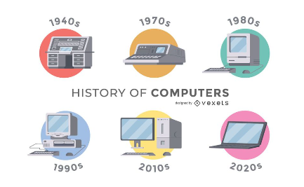
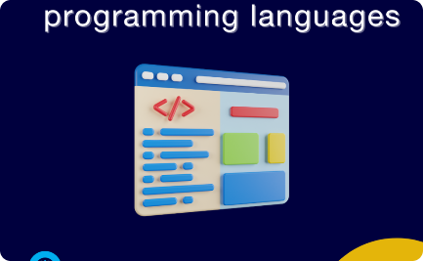

Development of C Language
Evolution of Computers
Birth of High-Level Languages
Dennis Ritchie: The Father of C
Understand the historical context behind the development of the C language, from early computing machines to modern computers.
Discover how the need for more efficient programming led to the development of high-level languages and influenced the creation of C.
Learn about Dennis Ritchie's contributions to the development of C and his impact on the programming world.

Slide 6

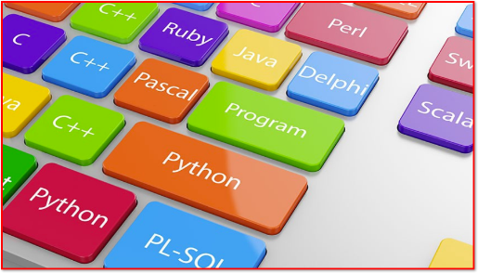
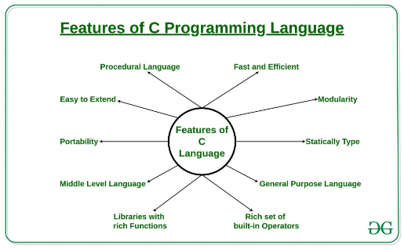
Why Learn C?
1
Foundation for other languages
2
Efficiency and Performance
C is considered the mother of all programming languages. Mastering C provides a solid foundation for learning other languages like C++, Java, and Python.
C is a powerful and efficient language. It allows you to write high-performance code and optimize system resources, making it a top choice for software development.
3
Embedded Systems
C is widely used in embedded systems, such as microcontrollers and IoT devices. Learning C opens up opportunities to work on exciting projects in these fields.

Slide 7

Application of C
1
Operating Systems
C is the language behind the development of operating systems like Windows, Unix, and Linux. It provides the low-level control necessary for efficient system operations.
2
System Software
C is used to create system utilities, device drivers, and compilers. It plays a critical role in building the software infrastructure that supports our modern digital world.
3
Game Development
Many game engines and frameworks, including Unity and Unreal Engine, leverage C for game development. It provides the speed and control required for building immersive experiences.

Slide 8
Conclusion
Whether you're a beginner or an experienced programmer, learning C is a valuable skill that opens up a world of possibilities. From building software to exploring creative ventures, programming with C empowers you to bring your ideas to life.

